Slide 1
Analyzing Crime Statistical Data Pulled from NIBRS
Jason Heitman
October 2026

Slide 2
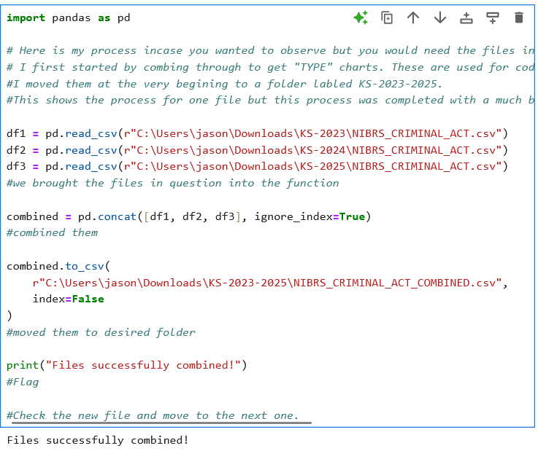
Starting Steps In the Process
Download the required files, https://cde.ucr.cjis.gov/LATEST/webapp/#/pages/home
I selected 2023-2025
I then put the type files into a separate folder where I plan on putting my data
Then I combined all the 2023, 2024, and 2025 data files

Slide 3
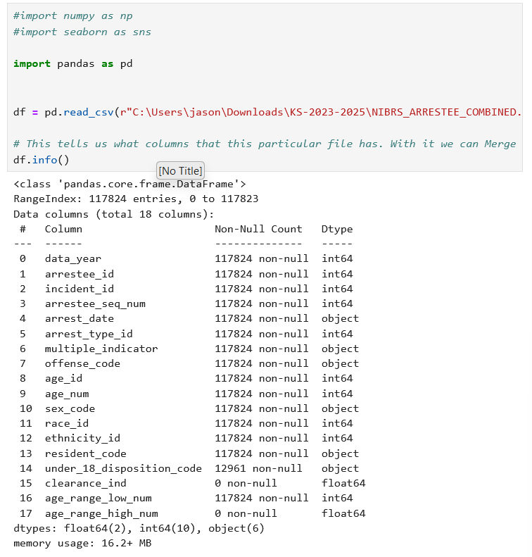
Combined and Ready to Go
Files were checked to see which can be merged based on column names
Files were added to the main arrest file
Arrest type and offense type were selected for this first instance
A month category was added to split it up more

Slide 4
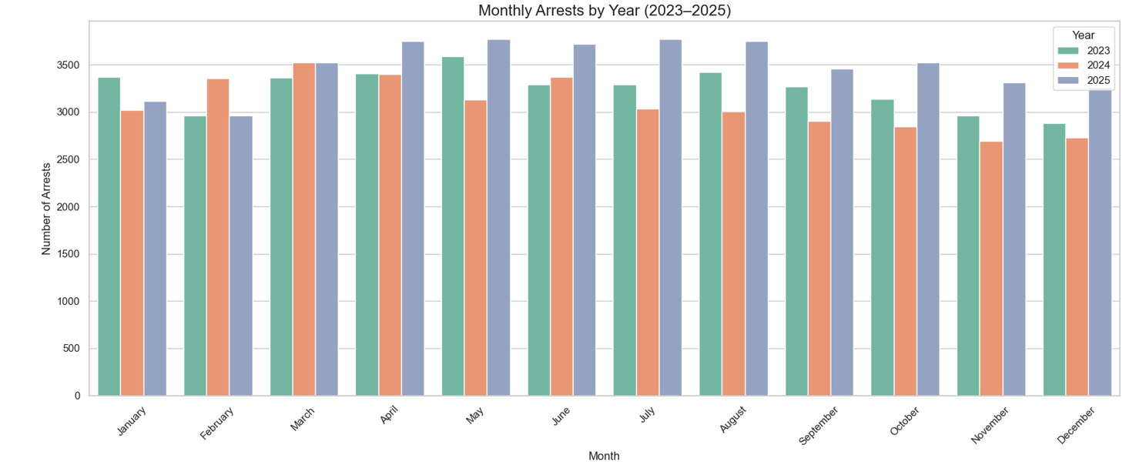
This shows us a basic bar graph of amount of arrest made each year, each month.

Slide 5
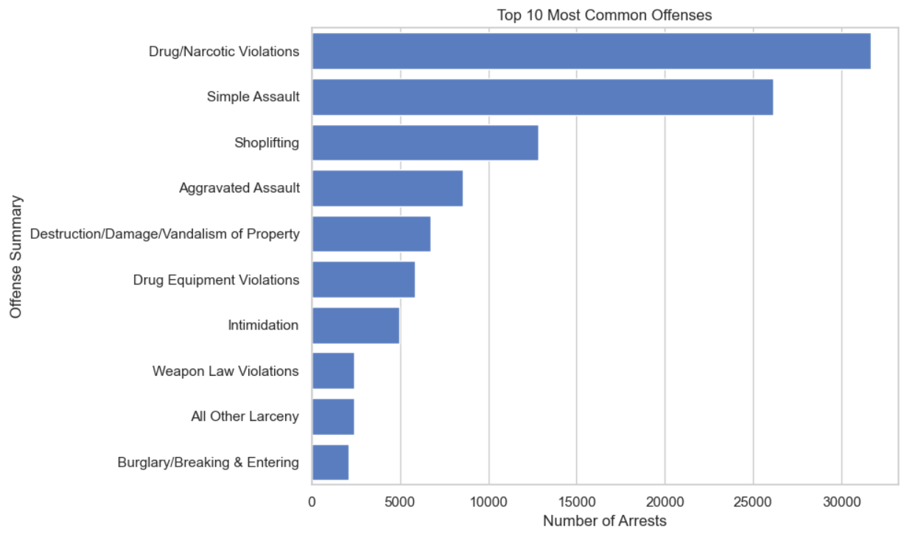
Analyzed the offense data and obtained the 10 most common offenses.
Across Kansas, Drug violations are the most common.

Slide 6
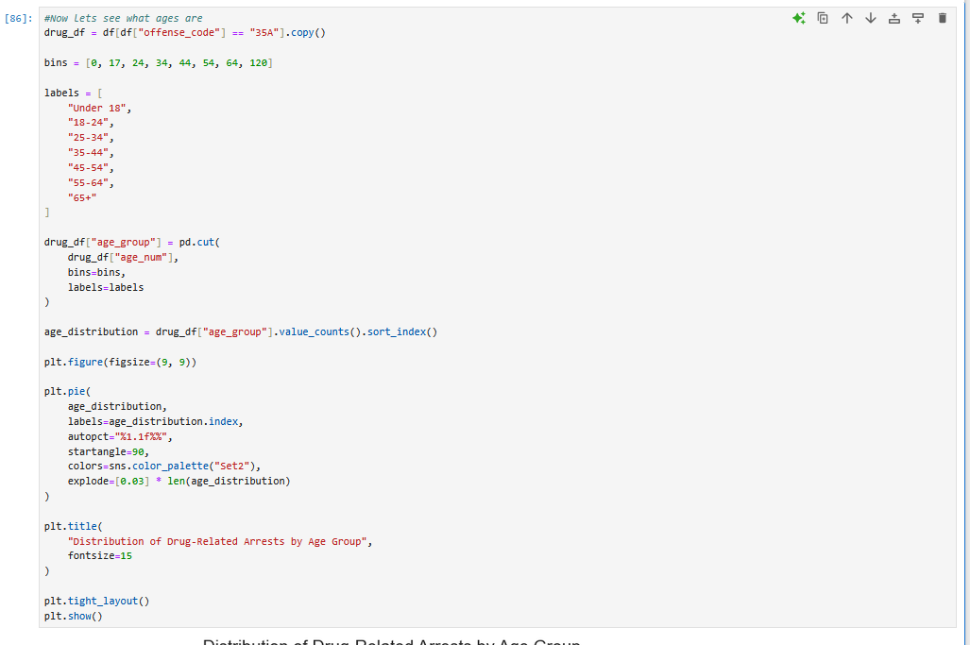
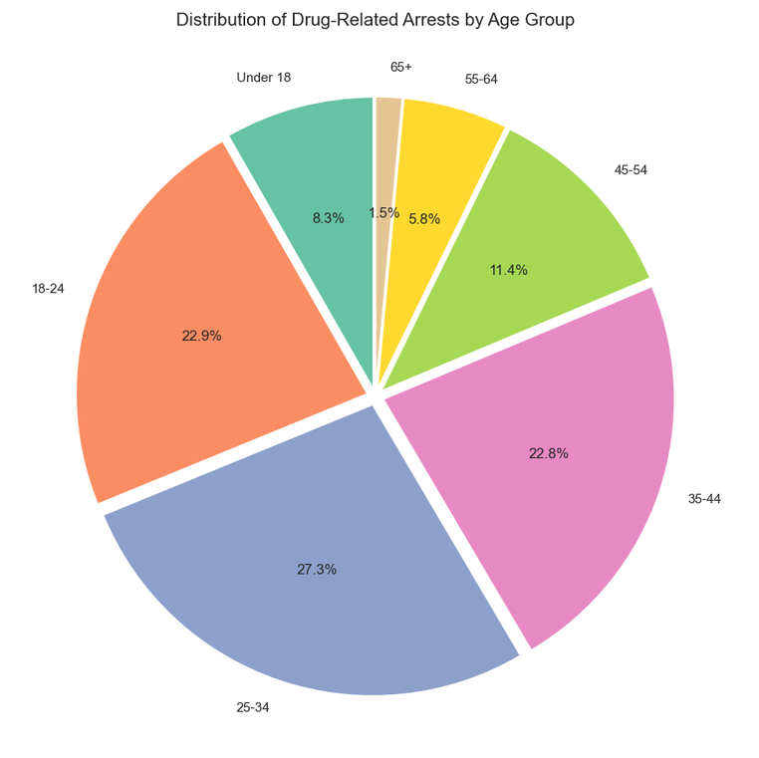
Investigated which age groups are affected in drug violations
Highest was 25-34, but not by much. All ages 18-44 seemed to be comparable.
Lowest was 65+

Slide 7
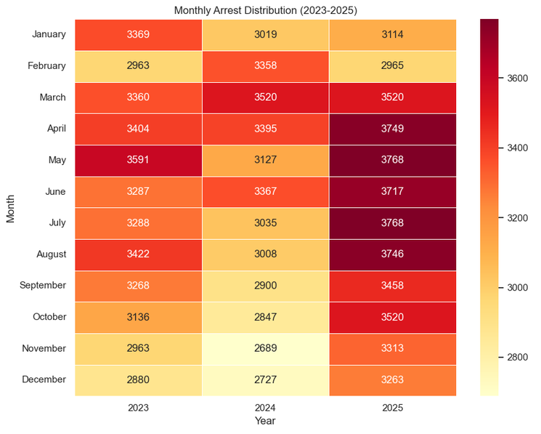
A heat map of arrests in the state of Kansas
Period of high activity between the spring and summer of 2025.
Period of low activity during last quarter of 2024.

Slide 8
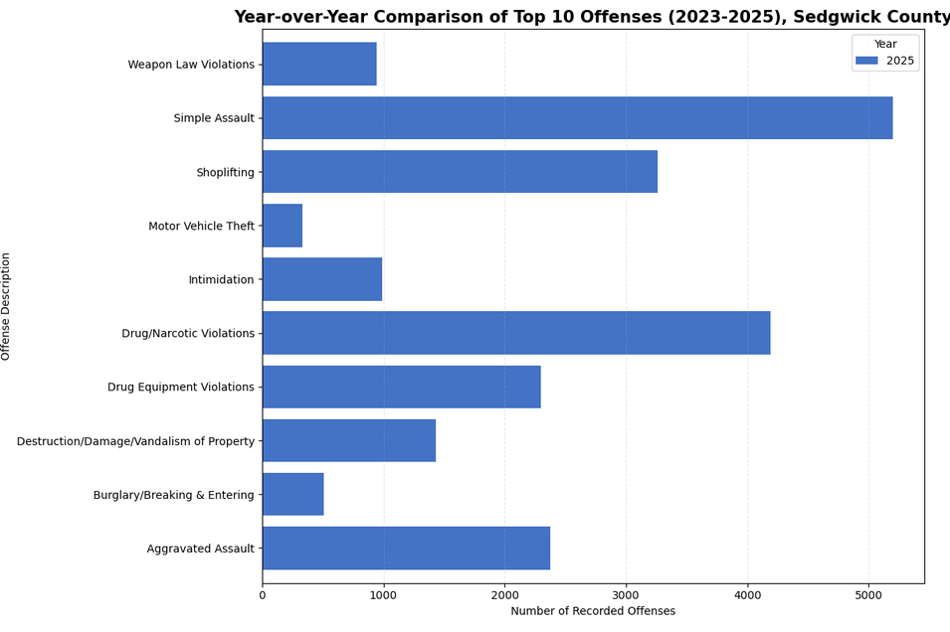
Narrowing to Sedgwick County
Narrowing the focus to Sedgwick County, Simple Assault cases overtake Drug Cases as the highest recorded offense.

Slide 9
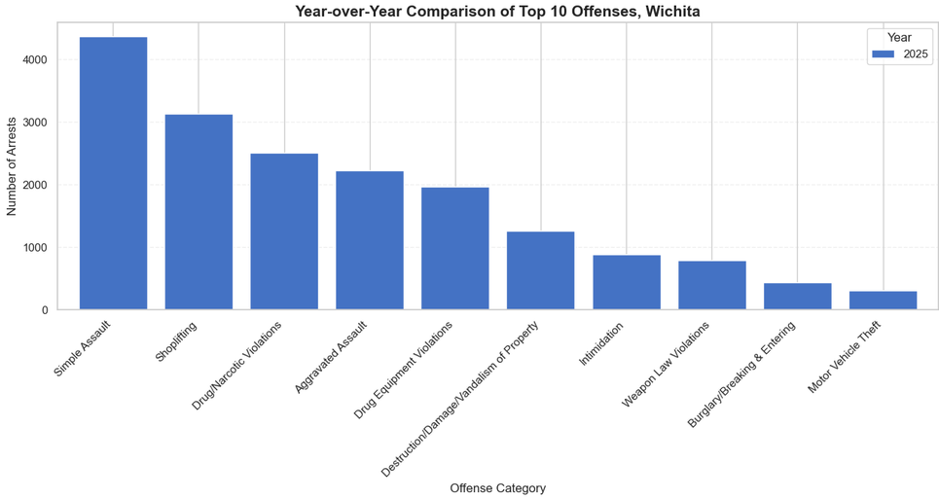
Narrowing the data focus further to Wichita looks very similar to the Sedgwick county data. Wichita is the largest portion of Sedgwick County (~75%).

Slide 10
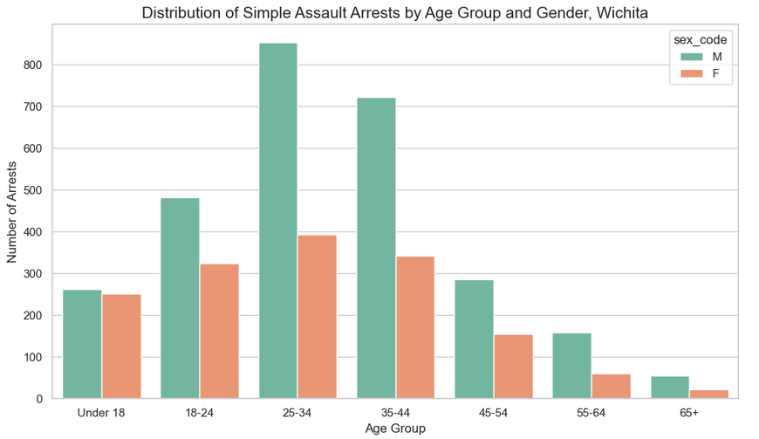
Breaking down the number of Simple Assault cases in Wichita by age shows that the highest number of assaults are committed by ages 25-44, and that males consistently commit more than double the number of assaults compared to females in the same age category.

Slide 11
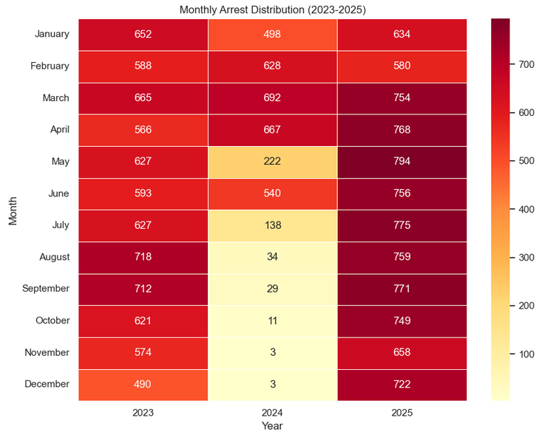
Heat map for wichita
One of the most interesting charts depicts arrests by month in Wichita for 2023 through 2025.
There is a clear, steep drop in arrests during the second half of 2024.
Open Source Intelligence research indicates one possible cause for this could be the police staffing shortages that happened around the end of 2024 (according to the Wichita Eagle).
Another possibly less likely reason could be lack of data for unknown reasons during the latter half of 2024.

Slide 12
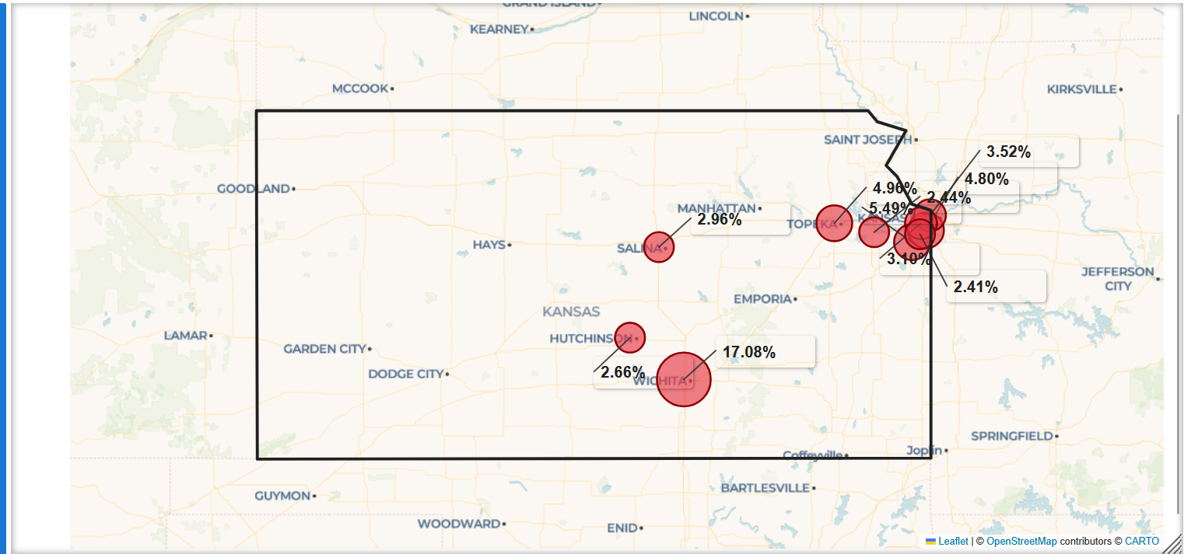
Finally, the top 10 cities in Kansas were analyzed for arrests between 2023 through 2025 to show the locations with the highest number of arrests. These top 10 cities account for nearly 50% of all arrests in Kansas, with Wichita having 3 times as much as the next highest city. Wichita is the largest city in Kansas with over 400,000 people.
Utilizing Folium with the provided API key yielded an ArcGIS style map to visualize levels of activity in different areas. More work could be done to dial in proportions and labeling of various areas.

Slide 13
Thank you for your time and consideration
Attached is a .ipynb file for proof of work.

